Slide 1

MATHEMATICS OF SECURE COMMUNICATION
Project Presentation
By
ANASWARA PYARILAL
DVAWSCM020
DEPARTMENT OF MATHEMATICAL SCIENCES
ST. JOSEPH’S COLLEGE(AUTONOMOUS),DEVAGIRI

Slide 2
Introduction to Cryptography
Cryptography is the science of securing communication using mathematical techniques.
It combines mathematics, computer science, and information theory to ensure data confidentiality, integrity and authenticity.
It ensures confidentiality, integrity, and authentication.

Slide 3
Key Terms in Cryptography
Plaintext: The message we want to send- readable data.
Ciphertext: Encrypted data that is unreadable and can only be read with a decryption key.
Encryption: Converting plaintext into ciphertext to make it unreadable to unauthorized parties.
Decryption: Reverting ciphertext back to plaintext for authorized users.
Private key: A cryptographic key that is part of a public-key cryptography system . It is used to encrypt messages and data.
Public key: A cryptographic key that is used to encrypt and decrypt data. It is also known as a secret key.

Slide 4
History of Cryptography
Started years ago , for the deliver of information only to authorized people.
Ancient cryptography: Egyptian hieroglyphs, Caesar shift method(Caesar cipher).
Modern cryptography: Enigma machine, digital encryption.

Slide 5
Evolution of Cryptography
Coding techniques has improved such as Vigenère coding came in to existence in the 15th century, which offered moving letters in messages with a number of variable places instead of moving them the same number of places.
The rise of mathematical rigor in the 20th century, Enigma machines were made during World War II, underscored the critical need for secure communication systems.
Thus after that many more systems where made using mathematical operations.

Slide 6
Types of Cryptography
Symmetric Key Cryptography: The cryptographic method in which the same key is used for both encryption and decryption of information
Asymmetric Key Cryptography: The cryptographic scheme that requires two different keys. One key is used for the encryption process, and the other is used for the decryption of the ciphertext.
Hashing : It is the process of transforming any given key or a string of characters into another value.

Slide 7

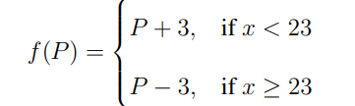
Some Cryptosystems
An enciphering transformation is a function that takes plaintext message unit and gives ciphertext message unit and deciphering transformation is ciphertext back to plaintext message unit.
ie, if we consider it as function,
Such set up is called Cryptosystem.
Shift Transformation: Suppose we are using the 26-letter alphabet A-Z with numerical equivalents 0-25.
  Example- Let the letter P∈ {0, 1, 2, . . . , 25} stand for a plaintext message . A function defined is,
With this system the word “YES” converts to “VHV”

Slide 8
Cryptoanalysis: The science of breaking codes is called cryptanalysis.
To break a cryptosystem, one needs to understand its general structure and determine specific parameters, such as the shift value b in a shift cipher.
For example, if we intercept the encrypted message "FQOCUDEM“
we get 20 ≡ 4 + b mod 26, giving b = 16.
Deciphering "FQOCUDEM" by subtracting 16 (mod 26) yields "PAYMENOW", revealing the original message.
Affine Transformation: Improves upon simple shift ciphers by using the transformation C ≡ aP + b mod N, where a and b form the enciphering key.
Decryption requires solving P ≡ a′C + b′ mod N, ensuring gcd(a, N) >= 1 for uniqueness.

Slide 9
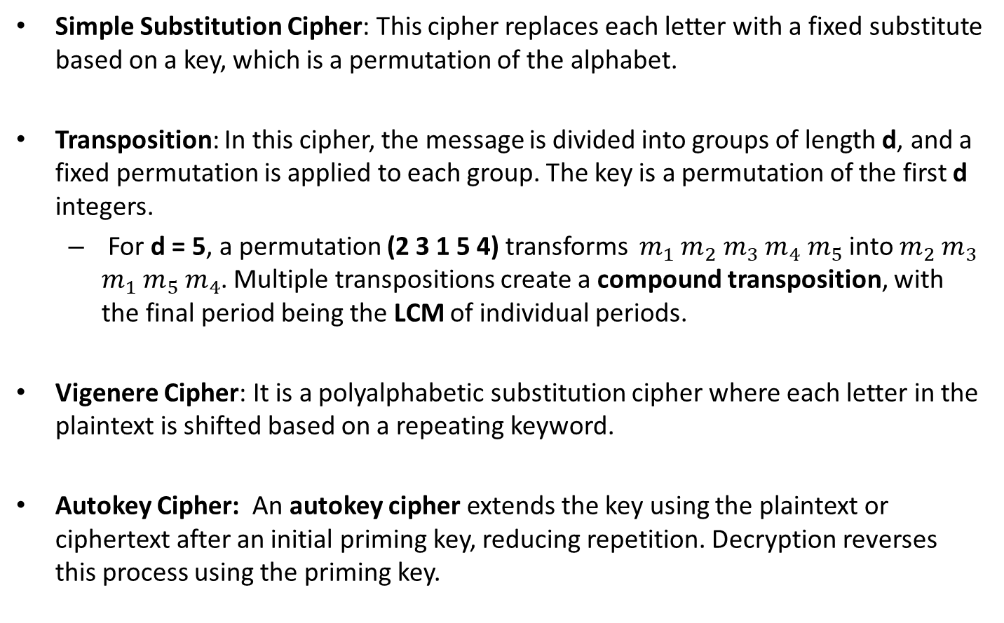
Some Examples of Secrecy Systems
Simple Substitution Cipher: This cipher replaces each letter with a fixed substitute based on a key, which is a permutation of the alphabet.
Transposition: In this cipher, the message is divided into groups of length d, and a fixed permutation is applied to each group. The key is a permutation of the first d integers.
  For d = 5, a permutation (2 3 1 5 4) transforms ${ m}_{1}$ $m_{2} m_{3}$ $m_{4} m_{5}$ into $m_{2}$ $m_{3}$ $m_{1}$ $m_{5}$ $m_{4}$. Multiple transpositions create a compound transposition, with the final period being the LCM of individual periods.
Vigenere Cipher: It is a polyalphabetic substitution cipher where each letter in the plaintext is shifted based on a repeating keyword.
Autokey Cipher: An autokey cipher extends the key using the plaintext or ciphertext after an initial priming key, reducing repetition. Decryption reverses this process using the priming key.

Slide 10
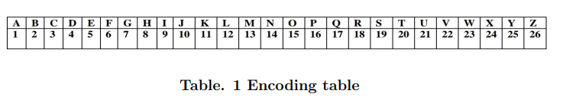
Graph Theory in Cryptography
Graph theory is used to model secure communication networks.
We represent each character of the message to be encrypted as the vertices of the graph & edges store encrypted values.
By using a keyword, we encode the message in such a way that each letter of the message would be converted to the number of letters between it and the corresponding letters of the keyword using the encoding table.

Slide 11
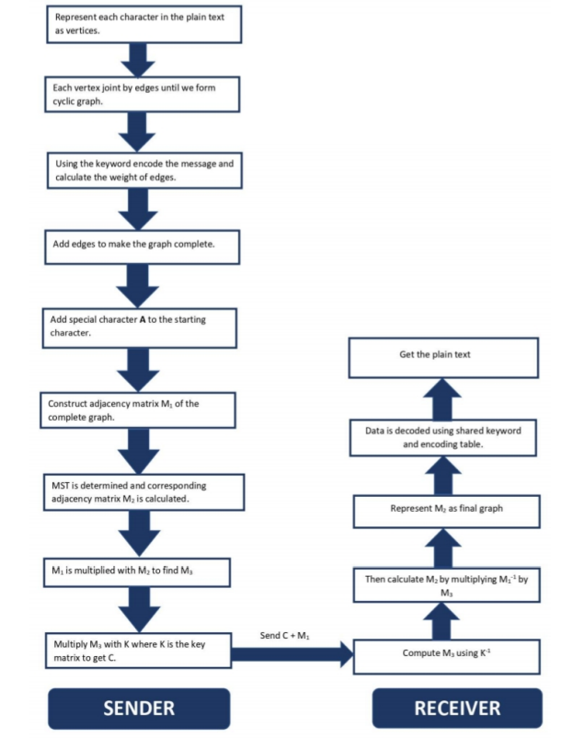

Slide 12
Proposed Algorithm
Encryption converts plaintext into a graph, forming a cyclic structure with vertices as characters.
A keyword encodes letters, and edge weights are computed.
The graph is completed, and an adjacency matrix M1 is formed.
A Minimum Spanning Tree (MST) generates M2, which is modified and multiplied with M1 and a shared key K to produce ciphertext C.
Decryption reverses this process using the inverse of K and M1 to reconstruct the original message.

Slide 13
Cryptography in Daily Life
Used in Whatsapp Encryption:
  How it uses?
    End-to-End Encryption (E2EE)
    Public and Private key pair
    Session Keys for Secure Communication
    Forward Secrecy
    Verifying Encryption

Slide 14
Cryptography in Daily Life
Used in Network Security:
  How does graphs used in cryptography?
    They provide a mathematical structure that allows complex problems to be represented visually and computationally.
    Finding the shortest or most complex paths, are also used in encryption methods to make breaking the security system extremely difficult.

Slide 15
Conclusion
It is evident that cryptography has transitioned from being a military tool to an indispensable aspect of everyday life, ensuring confidentiality, integrity, authentication, and non-repudiation in digital communications.
References:
  1.Cryptography: Theory and Practice by Douglas R. Stinson
  2. Cryptography: An Introduction by V.V. Yaschenko

Slide 16
THANK YOU

